Slide 1

Hate Speech and Offensive language detection.
BY NATALIA KATCHOURA

Slide 2
The Problem
This project addresses the important problem of discerning hateful content in social media. Toxic online speech has become a crucial problem nowadays due to an exponential increase in the use of internet by people from different cultures and educational backgrounds.

Slide 3
The Solution
Differentiating if a text message belongs to hate speech and offensive language is a key challenge in automatic detection of toxic text content. In this paper, we propose an approach to automatically classify tweets into three classes: Hate, offensive and Neither.

Slide 4
The Solution(cont.)
We propose a detection scheme that is an ensemble of Recurrent Neural Network (RNN) classifiers, and it incorporates various features associated with user-related information, such as the users’ tendency towards racism or sexism.

Slide 5
Text Wrangling
and
Pre-processing
Lowercase text
Remove whitespace
Remove numbers
Remove special characters
Remove emails
Remove stop words
Remove NAN
Remove weblinks
Expand contractions (if possible not necessary)
Tokenize
Twitter data was used to research hate-speech detection. The text is classified as: hate-speech, offensive language, and neither

Slide 6
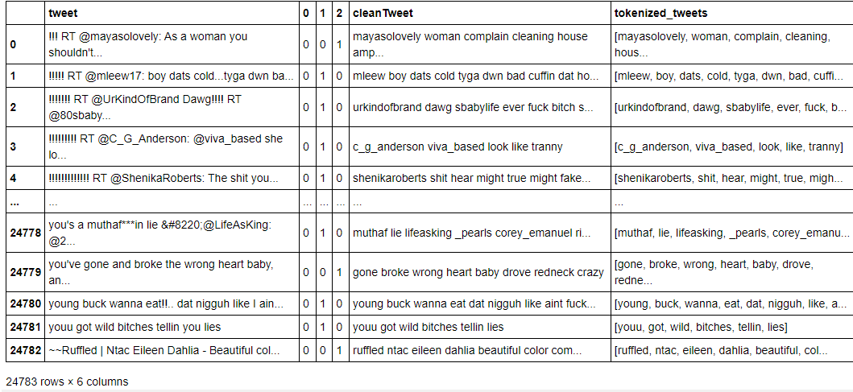
Original tweets, clean tweets, tokenized tweets

Slide 7
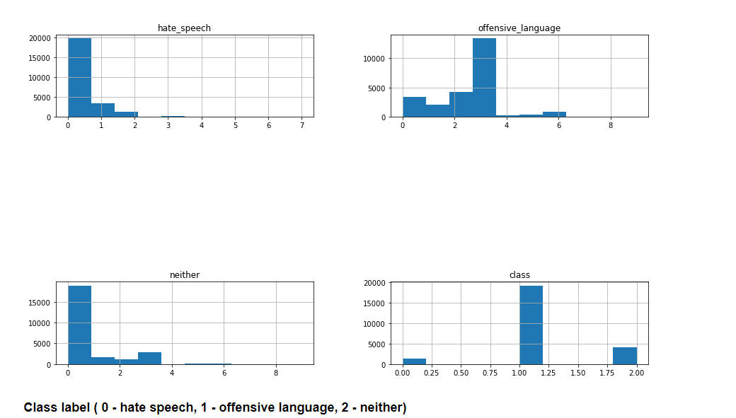
Exploratory Data Analysis
Column distribution

Slide 8
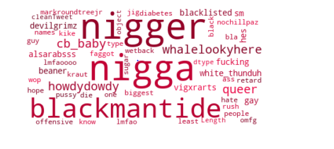
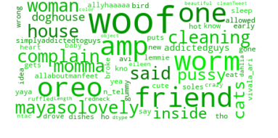
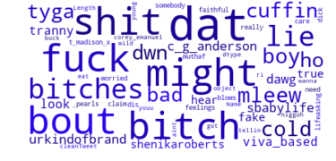
Word clouds
Hate speech Offensive language Neither

Slide 9
Word Embedding
Algorithms for obtaining vector representations for words
Supervised with NLP - bag of words and TF-idf
Unsupervised learning GloVe.

Slide 10
Models
Use Multinomial Naive Bayes algorithm is a probabilistic learning method
Random Forest
Standard
With Class Weighting
Easy Ensemble for imbalanced classification
NN model

Slide 11
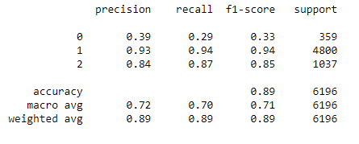
Comparison of the models
Naive Bayes using BoW performing better than NB using TF-idf
Accuracy score 87 vs. 79
Random Forest
Standard
With Class Weighting
Easy Ensemble for imbalanced classification
Naive Bayes (BoW) vs. Naive Naive Bayes (TF-idf)
Random Forest (for imbalance dataset)
We have unbalanced dataset we use F1 score instead of accuracy for model validation. RF with class weighting returned better F1 score

Slide 12
Comparison of the models(cont.)
We used GloVe embeddings, and summed up the embedding of each word in a tweet to obtain a representation of the tweet and used it as input to Recurrent Network
Test metrics with RNN:
Test accuracy: 0.7746933698654175
Test loss: -51091184.0
Test f1_score: 0.9696630239486694
Test precision: 0.942074716091156
Test recall: 1.0
Recurrent Neural Network (using GloVe embedding)

Slide 13
Future Research
* add other NLP models for research such as BERT, ELMo
* train recurrent neural network on a tweet emotion dataset to learn to recognize emotions in tweets

Slide 14
Thank you
NATALIA KATCHOURA
EMAIL: NATAKATCH@GMAIL.COM
FINAL REPORT :
https://github.com/natakatch/Springboard/blob/main/Capstone%20Three/Capstone%20Three_%20Hate_language_detection%20Final%20Report.pdf

